Slide 1
Social Media Sentiment Analysis
Aman Jawalekar

Slide 2
Problem Statement
Use NLP to analyze customer sentiment from social media platforms (e.g., Twitter) to understand public
perception of the brand.

Slide 3
Data Collection
The dataset for this project was sourced from Kaggle’s Twitter Entity Sentiment Analysis collection. It contains 74,681 records organized into four columns: ID, Entity, Sentiment, and Tweet.
The data consists of tweets mentioning various brands and entities, each labeled with a sentiment category—Positive, Negative, or Neutral—making it suitable for sentiment classification tasks.
This dataset was compiled from Twitter posts, ensuring a diverse range of opinions across different entities. Since it is pre-labeled, it allows for efficient application of supervised learning techniques, and it adheres to privacy standards by excluding any personally identifiable information.
Dataset – https://www.kaggle.com/datasets/jp797498e/twitter-entity-sentiment-analysis/data

Slide 4
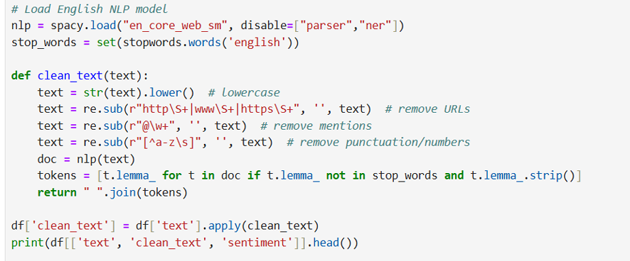
Text Pre-Processing
The code demonstrates the data preprocessing stage of a natural language processing (NLP) project for sentiment analysis.
The main objective is to clean and prepare raw text data for analysis by a machine learning model. It uses the spaCy library for advanced text processing and regular expressions for initial cleaning

Slide 5
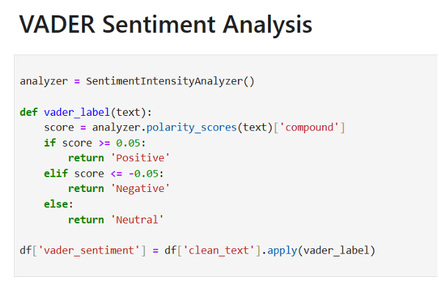
The code initializes an instance of SentimentIntensityAnalyzer, which is the VADER model. VADER does not require training and works by using a pre-built dictionary of sentiment-ranked words.

Slide 6
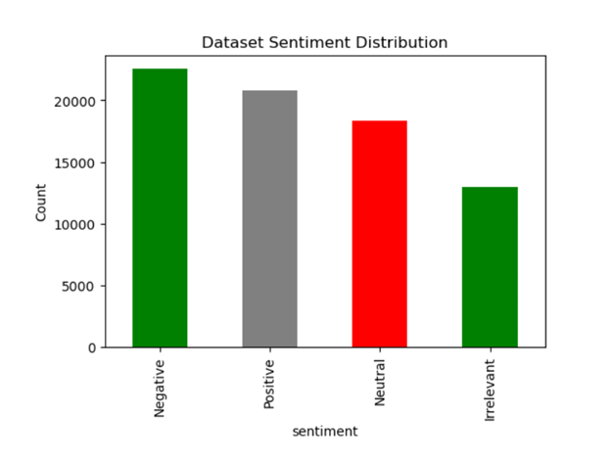
Exploratory Data Analysis

Slide 7
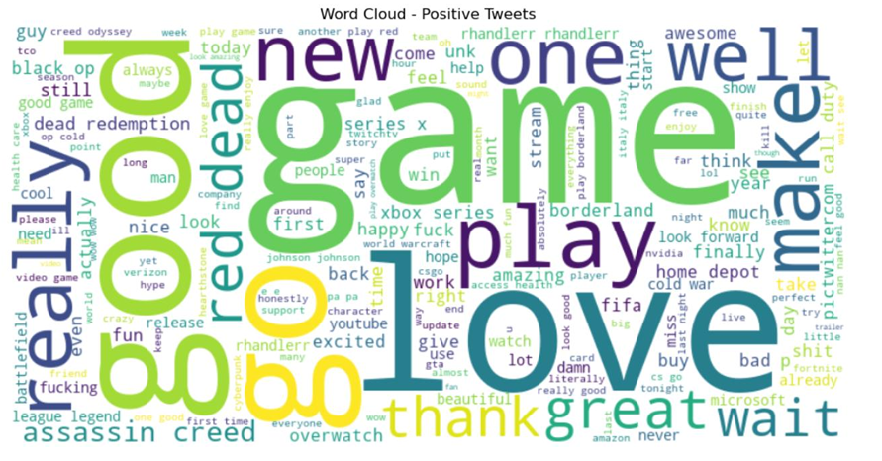
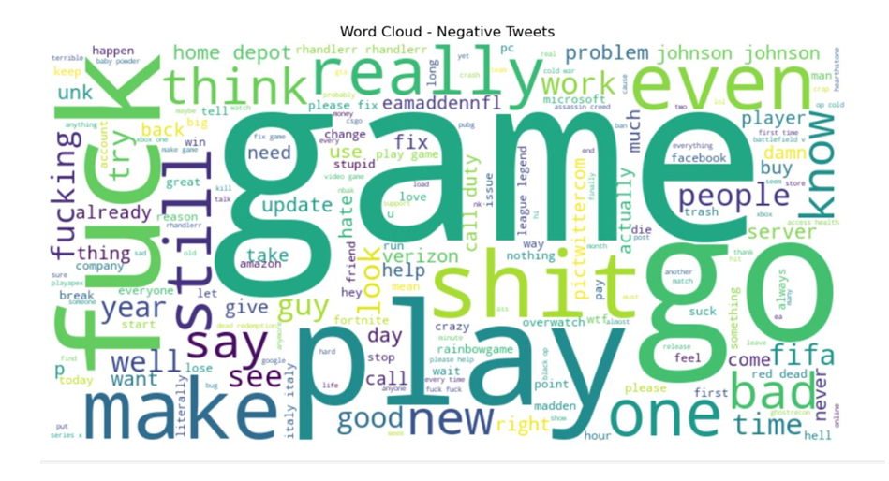
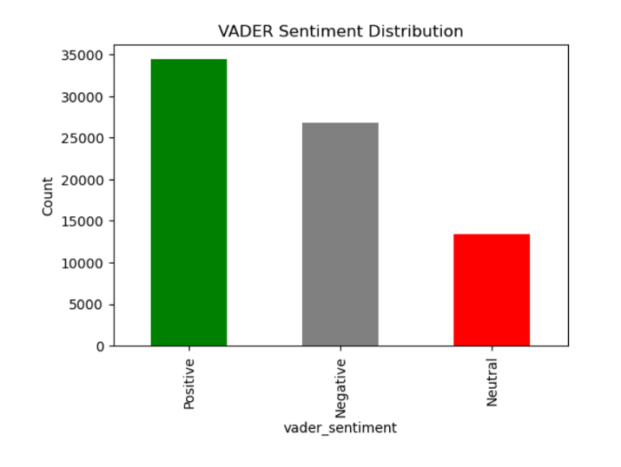
Result

Slide 8
Strategies to Improve Brand Perception
Identify Key Pain Points: Detect recurring complaints via negative sentiment spikes and respond quickly.
Amplify Positive Experiences: Promote positive feedback through retweets, testimonials, and campaigns.
Engage Proactively: Address neutral/mixed sentiments with FAQs, tutorials, and live Q&A sessions.
Monitor Trends: Track sentiment over time and plan communication during updates or launches.
Personalize Communication: Segment audiences by sentiment and tailor marketing or support accordingly.

Slide 9
Thank You

